Slide 1
Selenium-4
What’s new in Selenium 4 (WebDriver)

Slide 2
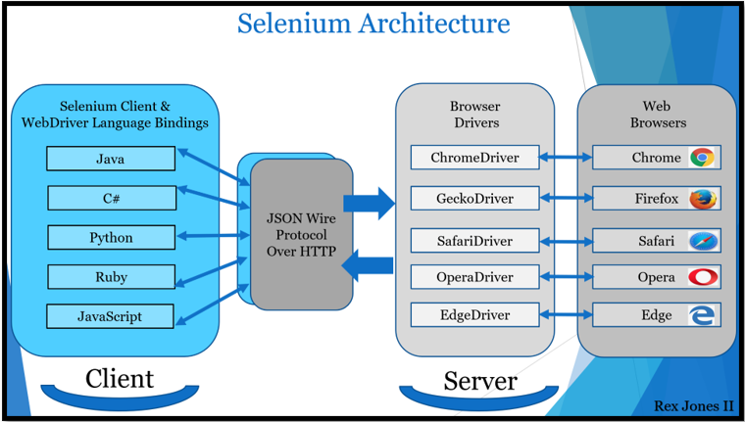
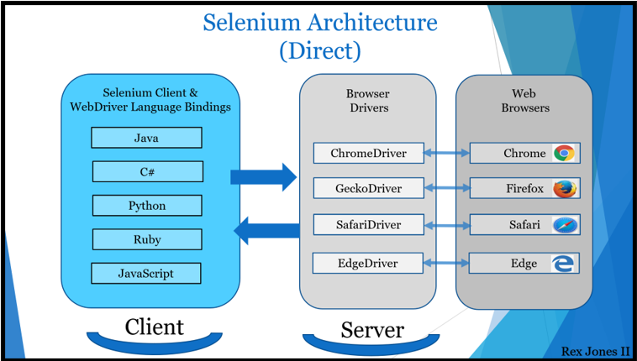
1- Selenium is now W3C compliant
JSON wire protocol was used to communicate between the Selenium WebDriver APIs and the browser native APIs
With W3C compliance, the communication happens directly without any encoding and decoding required. In a nutshell, JSON wire protocol is deprecated in Selenium 4.
Any software following W3C standard protocol can be integrated with Selenium with no compatibility issues
With W3C compliance, communication is more faster and stable now.

Slide 3
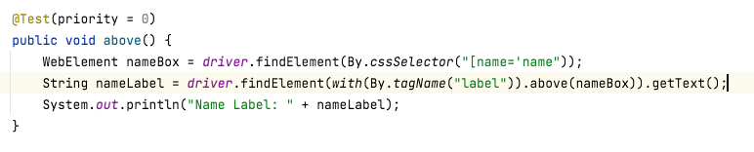
2- Relative Locators in Selenium 4
Selenium 4 brings an easy way of locating elements with the inclusion of relative locators. This means testers can now locate specific web elements using intuitive terms that are often used by users like:
To left of
To right of
Above
Below
The introduction of this new method in Selenium 4 helps locate web elements based on the visual location relative to other DOM elements.
Note: Relative locators don't work for Flex Web Elements. This is a bug for Selenium. I think they fix this issue soon.

Slide 4
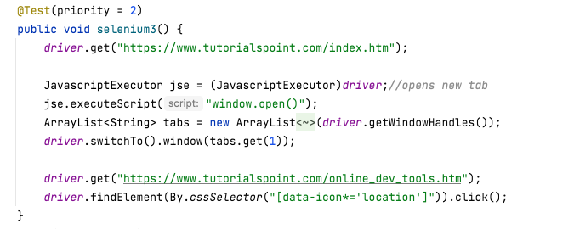
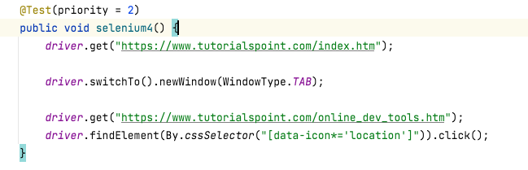
3- Better Window/Tab Management in Selenium 4
There are several instances in test automation wherein one might need to open a particular link in a new tab or window to perform certain actions. To achieve this in Selenium 3, QAs had to create a new driver object and then perform the switch operation using the WindowHandle method to perform subsequent steps.
This is set to change in Selenium 4 as it comes with a new API – newWindow that allows users to create and switch to a new window/tab without creating a new WebDriver object.
driver.switchTo().newWindow(WindowType.WINDOW);
driver.switchTo().newWindow(WindowType.TAB);

Slide 5
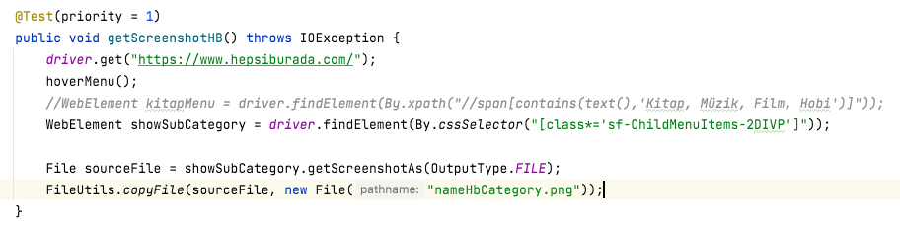

4- Taking WebElement Partial Screenshot with Selenium
With Selenium 4, we can take screenshot of just a Web Element which we need.
WebElement.getScreenshotAs()
For example, if we want to focus an area in all test scripts, taking screenshot of the element may be useful to us.

Slide 6
5- Support for Chrome Debugging Protocol
Selenium 4 comes with native support for Chrome DevTools Protocol. This means QAs can now use Chrome development properties like Fetch, Network, Profiler, Performance, Application cache, and more.
The following steps are some of examples which we can do by using Selenium.
Capture, Monitor and Stub the Network requests and responses
Inject Session Cookies and Perform basic Auth
Mock Device Coordinates for Mobile/Tabs view
Check and monitor the site’s performance
Mock geolocations of the user
Block the Network requests
Mock faster/slower networks speeds
Execute and debug JavaScript

Slide 7
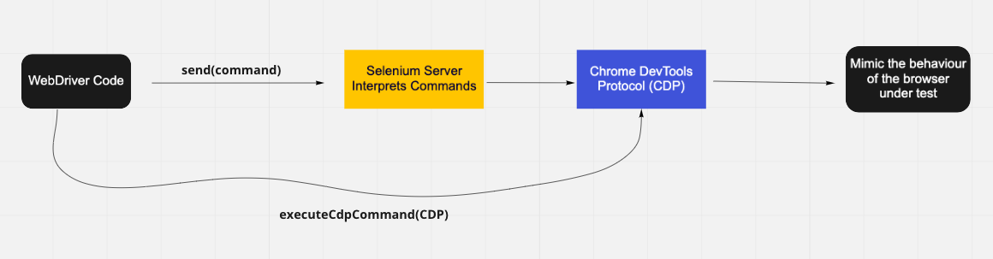
5- Support for Chrome Debugging Protocol
How does it work?
As you see below in the flow-chart, there are two ways of working with CDP APIs.
send() : Selenium developers has created own classes (own library) for most CDP APIs which useful for automation. So we can access directly to these methods.
executeCdpCommand(): Some CDP APIs have not class (library) at Selenium side. So if we need to access these APIs, we use executeCdpCommand method. This method directly communicate with CDP APIs.
When we need to work with CDP APIs, we can check (parameter type etc) all APIs in detail at below official address.
https://chromedevtools.github.io/devtools-protocol/

Slide 8
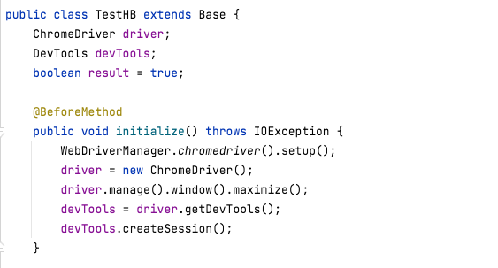
5- Support for Chrome Debugging Protocol
What need to be done before start using CDP methods?
Firstly, use ChromeDriver instead of WebDriver
ChromeDriver is used to interact with Chromium-based browsers such as Google Chrome and Microsoft Edge. So, CDP APIs are just accessible for Chrome and Microsoft Edge browsers.
Next, create an object from getDevTools()
This object provides us to access CDP APIs.
Finally, use createSession() method to start using CDP APIs.

Slide 9
5- Support for Chrome Debugging Protocol – Some Examples
1- Mobile Emulator : With Selenium 4, we execute and view test scripts on Mobile Emulator. So we can check how the application works on mobile view.
During testing, we might want to place the application in various dimensions to trigger the responsiveness of the application.
devTools.send(Emulation.setDeviceMetricsOverride(x,y,z))
2- Localization Testing: With Selenium 4, We can set the browser location as if we were in a different location than where we are. For example, if we have a application which is used all around the world, we may need to check how the application works other locations. In this case, we may use the following method.
devTools.send(Emulation.setGeolocationOverride(x,y,z);
3- Check Network Responses and Status Codes: With Selenium 4, we can check APIs request-response data and status codes. So, we may check APIs response codes, then we may the test cases to fail when their response code 404,400 etc.
devTools.send(Network.enable(Optional.empty(), Optional.empty(), Optional.empty()));
devTools.addListener(Network.responseReceived()..)
4- Blocking Unwanted Network Request Calls to Speed Up The Execution
devTools.send(Network.enable(Optional.empty(), Optional.empty(), Optional.empty()));
devTools.send(Network.setBlockedURLs(ImmutableList.of("*.jpg", "*.css")));

Slide 10
5- Support for Chrome Debugging Protocol – Some Examples
5- Emulate Network Speed : Users can access web applications via handheld devices that are connected to wifi or cellular networks. We can test how the application behaves under such conditions where the internet connection is slow (2G) or goes offline intermittently.
devTools.send(Network.enable(Optional.empty(), Optional.empty(), Optional.empty()));
devTools.send(Network.emulateNetworkConditions(false, 3000, 20000, 100000, Optional.of(ConnectionType.ETHERNET)));
devTools.addListener(Network.loadingFailed(), loadingFailed))
6- Intercept Network /API Responses
devTools.send(Fetch.enable(Optional.empty(), Optional.empty()));
devTools.addListener(Fetch.requestPaused(), request ->)
devTools.send(Fetch.continueRequest))
7- Intentionally Failing the API
devTools.send(Fetch.enable(patterns, Optional.empty()));
devTools.addListener(Fetch.requestPaused(), request ->)
devTools.send(Fetch.failRequest))
8- Logging JavaScript Errors
LogEntries entry = driver.manage().logs().get(LogType.BROWSER);//Get LogEntries object
List<LogEntry> logs = entry.getAll(); //LogEntry object- getAll method return all logs in list

Slide 11
6- Waits
Implicit Wait
Before Selenium 4
driver.manage().timeouts().implicitlyWait(10, TimeUnit.SECONDS);
After Selenium 4
driver.manage().timeouts().implicitlyWait(Duration.ofSeconds(10));
Explicit Wait
Before Selenium 4
WebDriverWait wait = new WebDriverWait(driver,10); wait.until(ExpectedConditions.visibilityOfElementLocated(By.cssSelector(”#bjkLocator")));
After Selenium 4
WebDriverWait wait = new WebDriverWait(driver,Duration.ofSeconds(10)); wait.until(ExpectedConditions.visibilityOfElementLocated(By.cssSelector("#bjkLocator")));

Slide 12
Other new features
Enhanced Selenium Grid
The new Selenium Grid comes with Docker support. This will enable developers or testers to spin up the containers rather than setting up heavy virtual machines. Moreover, it is redesigned in a way that will allow QAs to deploy the grid on Kubernetes for better scaling.
Upgraded Selenium IDE
Improved GUI for intuitive user experience.
The new IDE also comes bundled with a SIDE tool aka Selenium IDE runner. It allows QAs to run .side projects on a node.js platform. This SIDE runner also enables individual QAs to run cross browser tests on local or Cloud Selenium Grid.
Improved control flow mechanism that enables testers to write better “while” and “if” conditions.
The new IDE comes with an enhanced element locator strategy (Like a backup strategy) which helps locate an element in case the web element couldn’t be located. It will result in the creation of stable test cases.
The code for test cases recorded using Selenium IDE can be exported in the desired language binding like Java, C#, Python, .NET, and JavaScript.
Improved Documentation
The documentation section has been revamped significantly with a neat UI for navigating to the desired section or page. This will help testers and developers find relevant information they need for a specific tool, language binding, etc.
https://www.selenium.dev/documentation/

Slide 13
Resources
https://www.browserstack.com/
https://www.selenium.dev/documentation/
https://rahulshettyacademy.com/angularAppdemo/
https://www.seleniumeasy.com/selenium-tutorials/waits-and-timeout-selenium-4

Slide 14
THANK YOU ☺ by muhammet altunbas

